Slide 1
Evolution Strategies
KhangTD - KHTN2018

Slide 2
List of content
Problem Statement
Overview of ES
Basic Ideal and Algorithm
Recombinations
Parameters Control
Survivor Selection
CEM (Cross Entropy Method)

Slide 3
List of content
IV. CMA-ES
Sampling
Selection and Recombination
Adapting the Covariance Matrix
Step-Size Control

Slide 4

Problem Statement

Slide 5
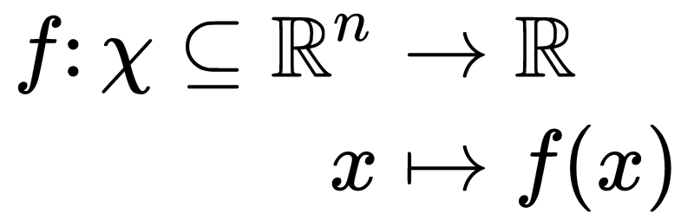
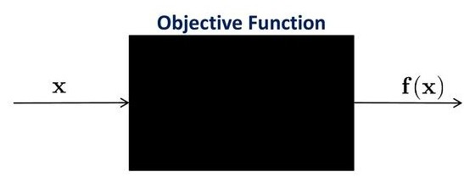
Continuous Domain Search/Optimization
Task: Minimize/Maximize an objective function (fitness function, loss function) in continuous domains.
Black box scenario (direct search scenario)
gradients are not available or not useful
problem domain specific knowledge is used only within the black box
Search costs: number of function evaluations

Slide 6

Continuous Domain Search/Optimization
Goal:
Fast convergence to the global optimum or to a robust solution x
Solution x with small function value f(x) with least search cost
Problems:
Exhaustive search is infeasible
Naive random search takes too long
Deterministic search is not successful / takes too long
Approach: Stochastic Search, Evolutionary Algorithms

Slide 7
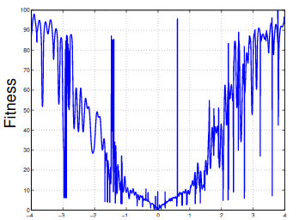

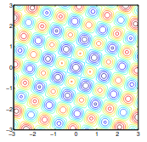
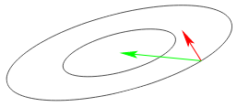
Some objective function of real-word problem?
f can be:
non-linear, non-quadratic, non-convex
Ruggedness
Non-separability
Ill-conditioning
dimensionality (size of search space) larger than three
. . .

Slide 8

Nikolaus Hansen
Senior researcher (directeur de recherche) at Inria
The CMA evolution strategy: a comparing review (2006)
The CMA Evolution Strategy: A tutorial (2016)
http://www.cmap.polytechnique.fr/~nikolaus.hansen/

Slide 9
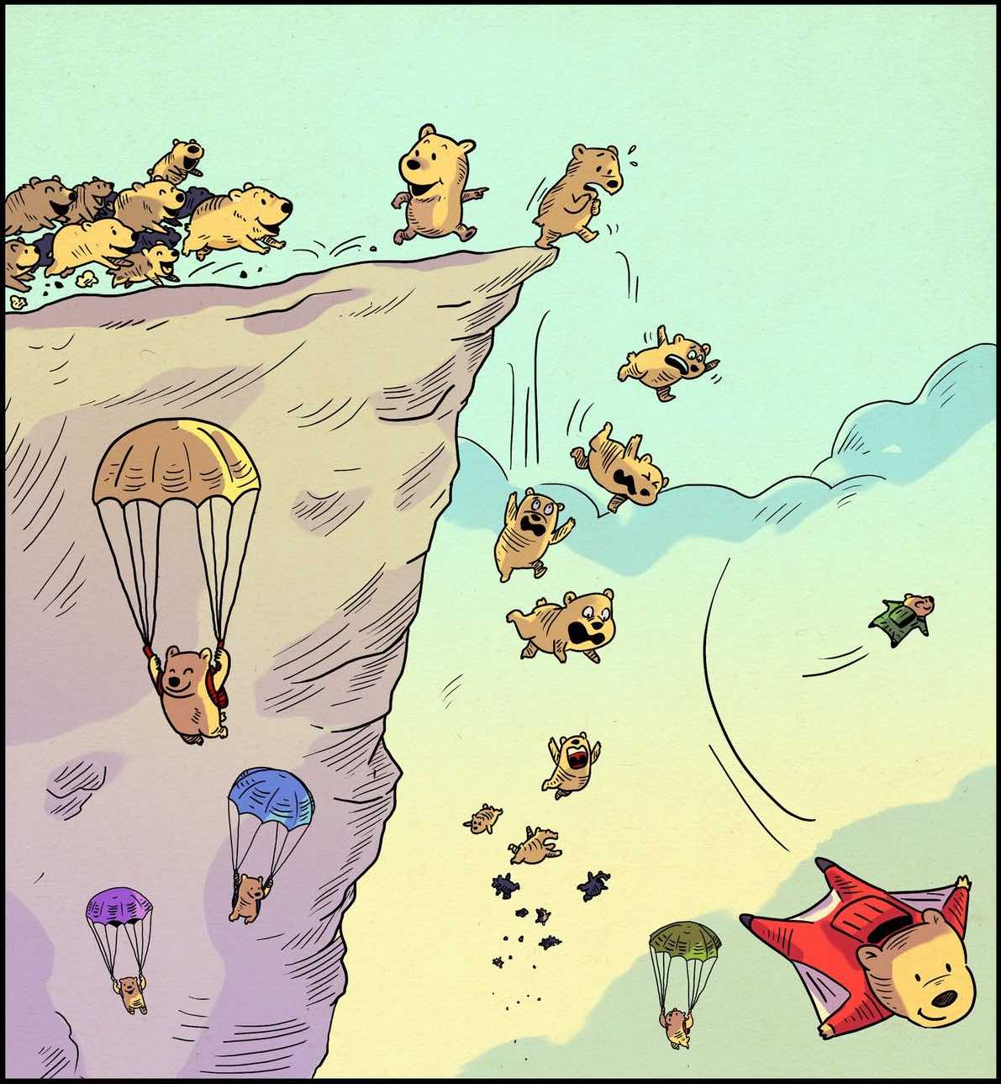
II. Overview of ES
2 drinking glasses
Table salt
2 eggs
Water

Slide 10
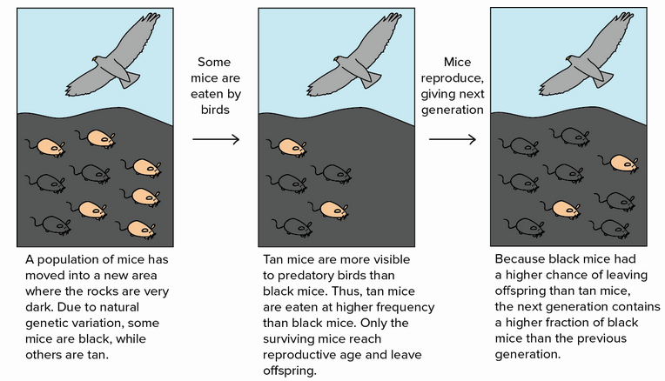
What are Evolution Strategies?
Evolution Strategies (ES): techniques used in solving continuous domain.
Evolution Strategies : inverted in early 1960s by Rechenberg and Schewefel.
Inspired by natural selection.

Slide 11
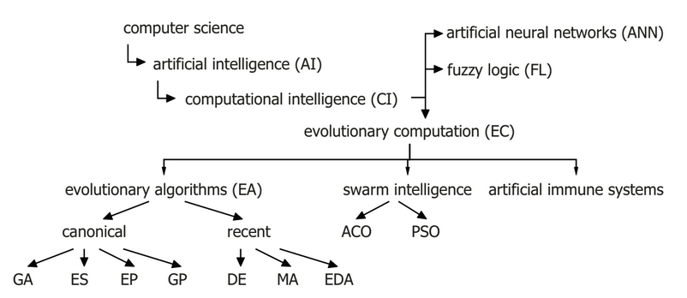
What are Evolution Strategies?
Evolution Strategies (ES) belong to the big family of Evolutionary Algorithms (EA)

Slide 12
Basic Idea
Initialisation
Create new population
(sampling, mutation)
Discrete Recombination
Recombination
Intermediate
Recombination
Weighted
Recombination
Termination
Update parameters

Slide 13
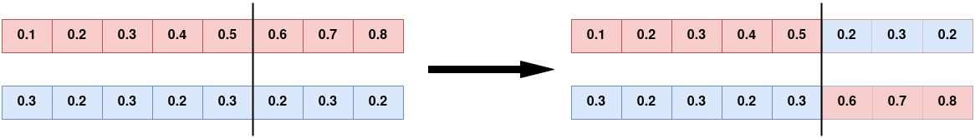
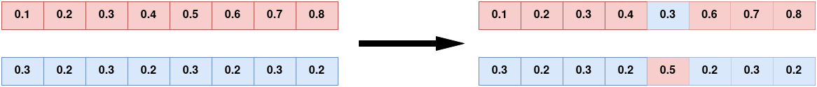
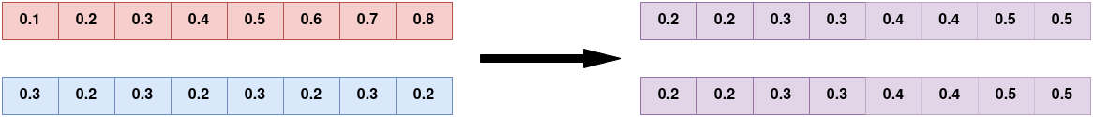
Discrete Recombination
Simple arithmetic recombination:
Single arithmetic recombination:
Whole arithmetic recombination:

Slide 14
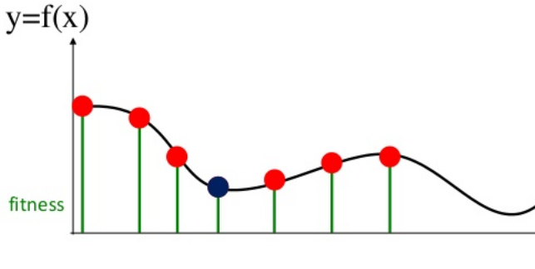
Intermediate Recombination
Takes the average value of all ρ parents (computes the center of mass, the centroid).

Slide 15
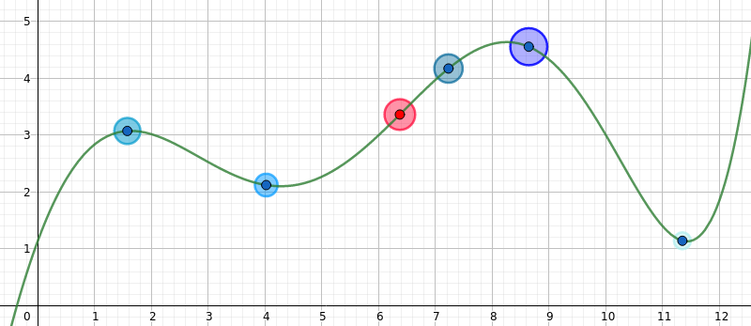
Weighted Recombination
Weighted Recombination is a generalization of intermediate recombination. It takes a weighted average of ρ parents.
The weight values depend on the fitness ranking, in that better parents never get smaller weights than inferior ones.

Slide 16


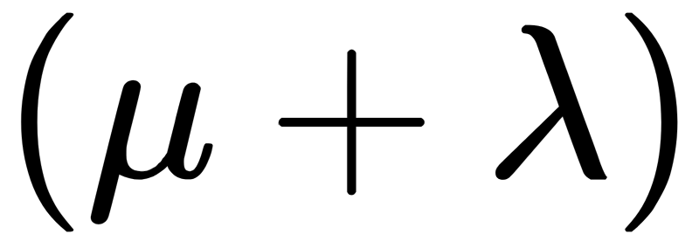
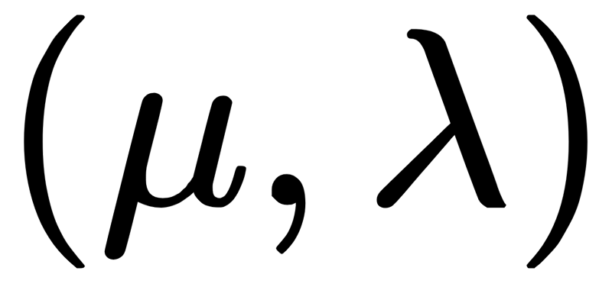
Survivor Selection
Applied create children from parents by mutation and recombination.
Two mechanism: Plus (elitist) and comma (non-elitist) selection
: selection new parents in {parent,offspring}
: selection new parents in {offspring}

Slide 17
Survivor Selection cont’d
is an elitist strategy
is truncation selection
Often is preferred for:
Better in leaving local optima
Better in following moving optima
Using “plus” selection, bad strategy parameter can survive in population too long, if an individual has relatively good objective variables.

Slide 18
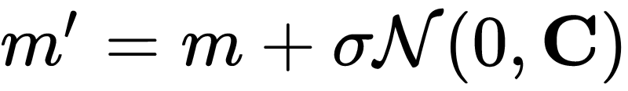
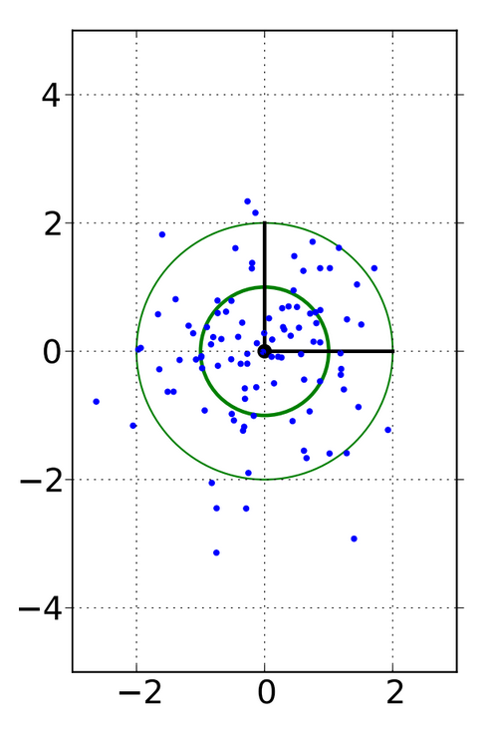
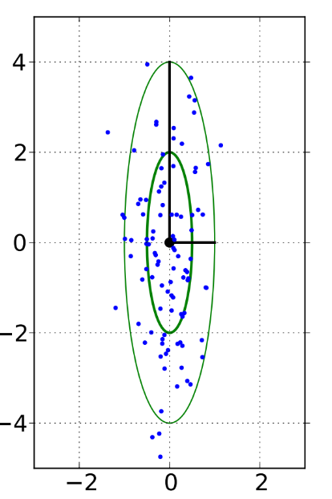
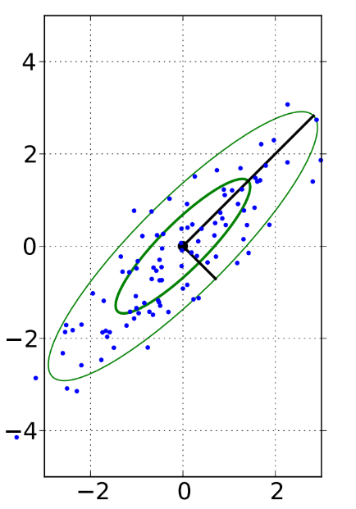
Mutation
The mutation operator introduces (“small”) variations by adding a point symmetric perturbation to the result of recombination.
Spherical/Isotropic:
C is identity matrix
Axis-parallel: C is diagonal (positive) matrix
General: C is symmetric and PSD matrix

Slide 19
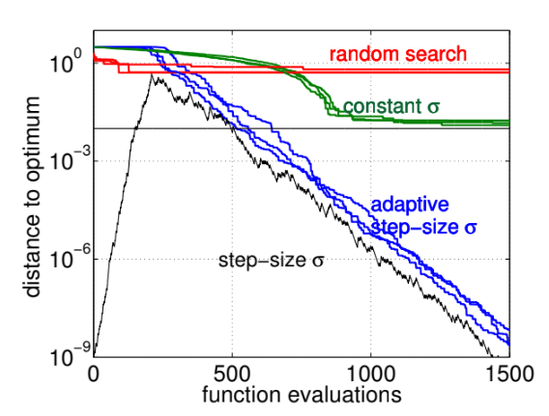
Parameters control
Controlling the parameters of the mutation operator is key to the design of evolution strategies and affects convergence speed.
Fig: Step-size affects convergence¹
¹Evolution Strategies, Nikolaus Hansen, Dirk V. Arnold and Anne Auger (2015)

Slide 20
Parameters control
1/5-th success rule, often applied with Plus - selection
increase step-size if more than 20% of the new solutions are successful,decrease otherwise
σ-self-adaptation, applied with Comma - selection
mutation is applied to the step-size and the better, according to the objective function value, is selected
path length control (Cumulative Step-size Adaptation, CSA)
self-adaptation derandomized and non-localized

Slide 21
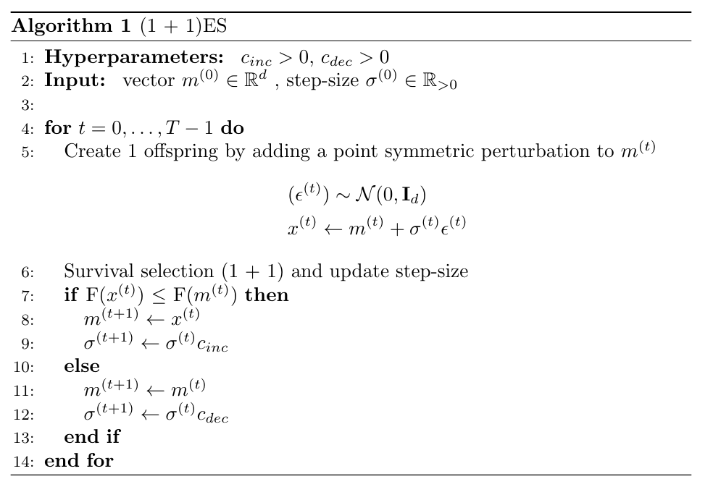
(1 + 1)ES

Slide 22
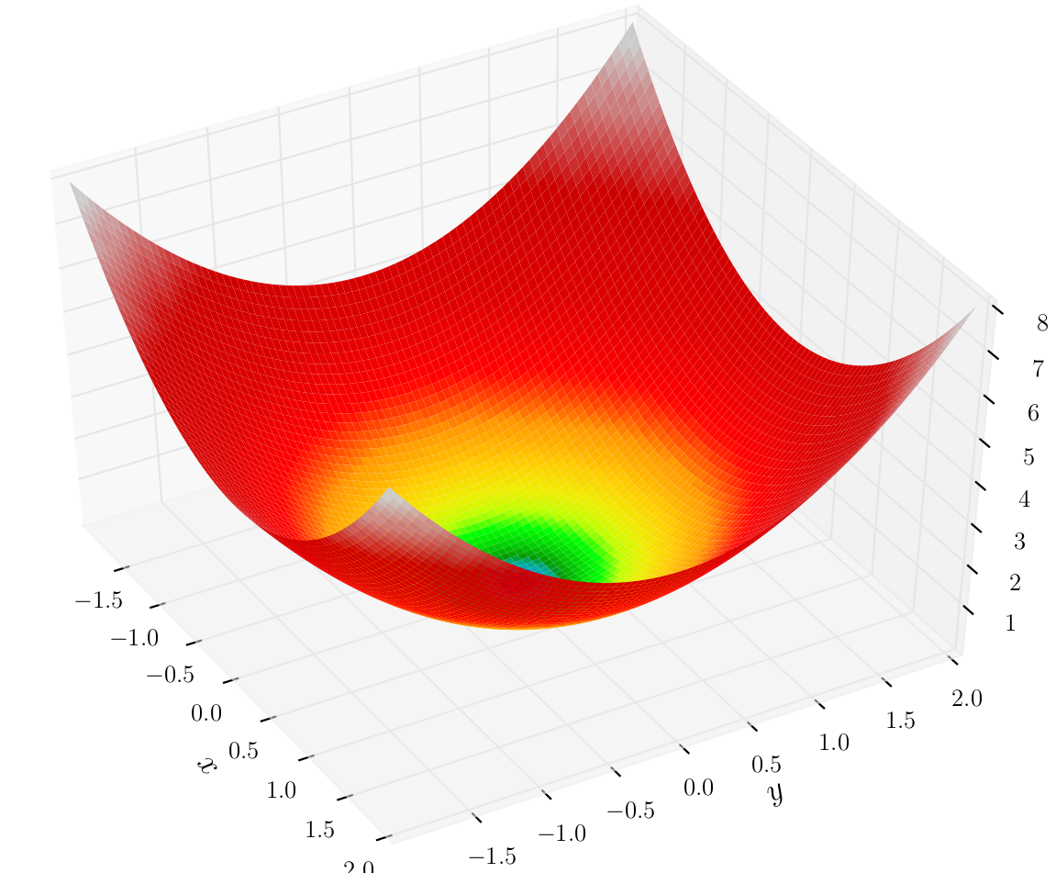
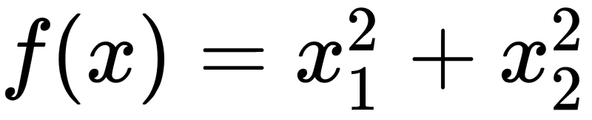
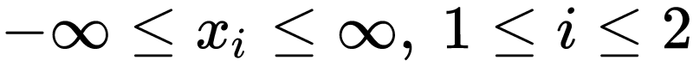
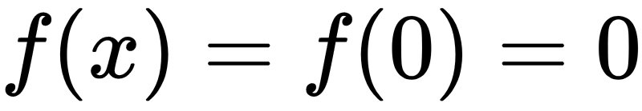
Test Function
Formula:
Formula:
Search domain:
Global minimum:
Sphere Function in 3D

Slide 23
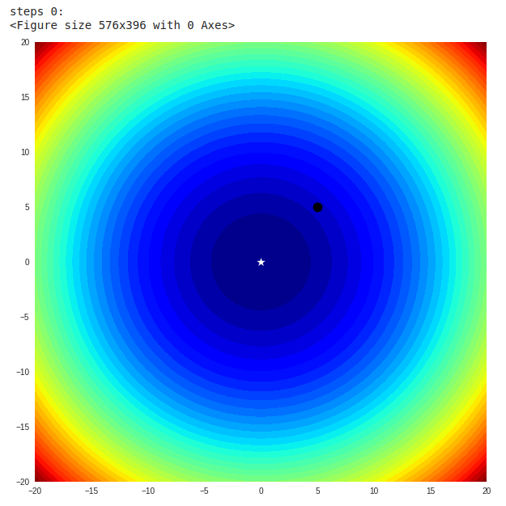
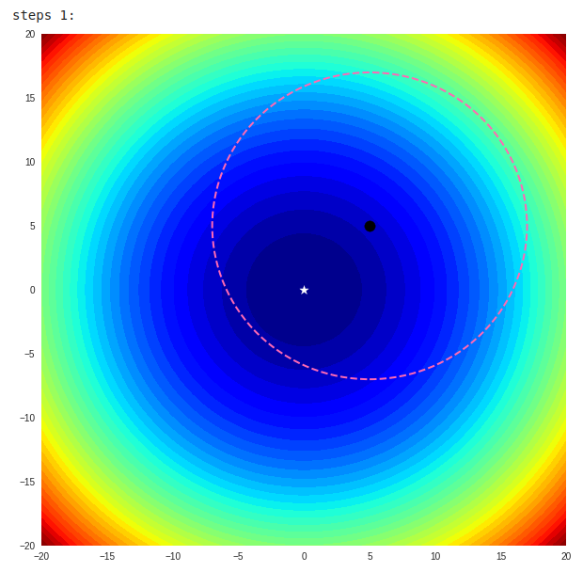

Slide 24
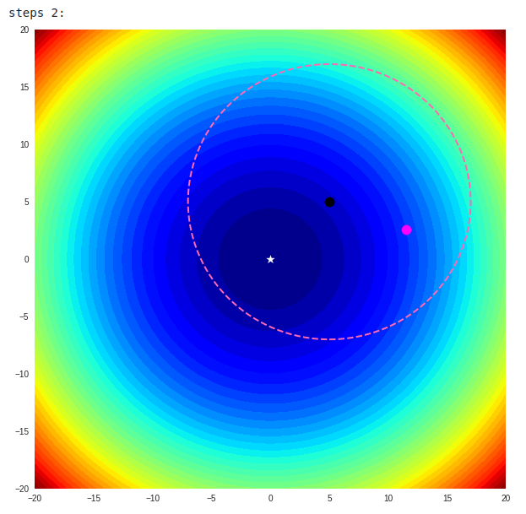
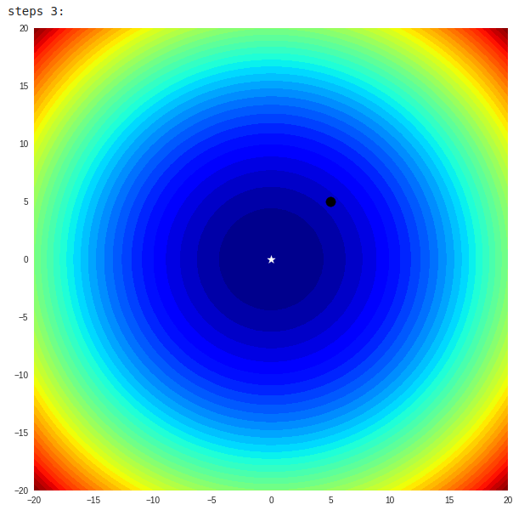

Slide 25
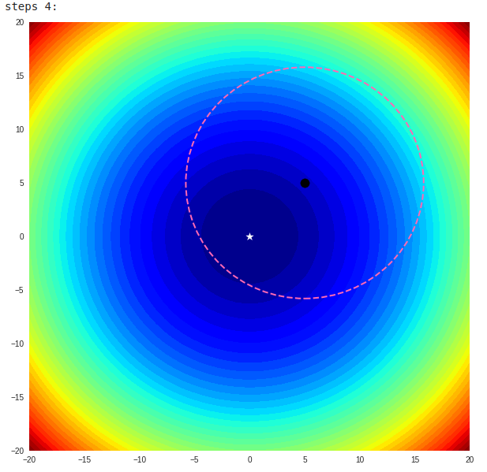
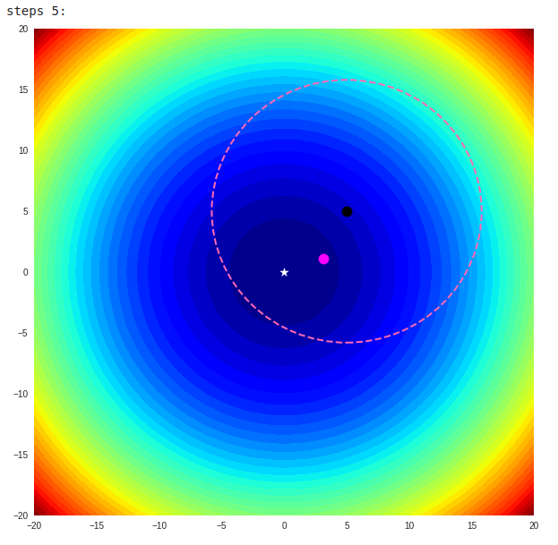

Slide 26

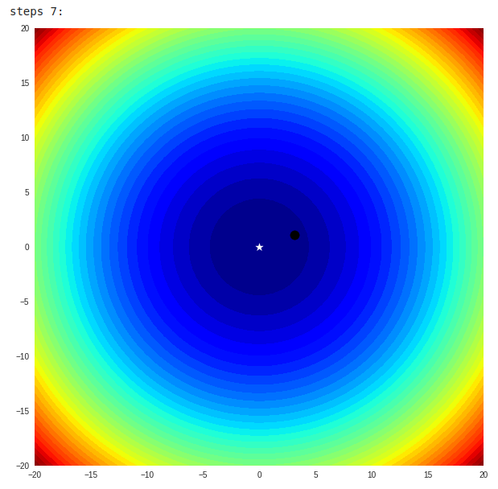

Slide 27
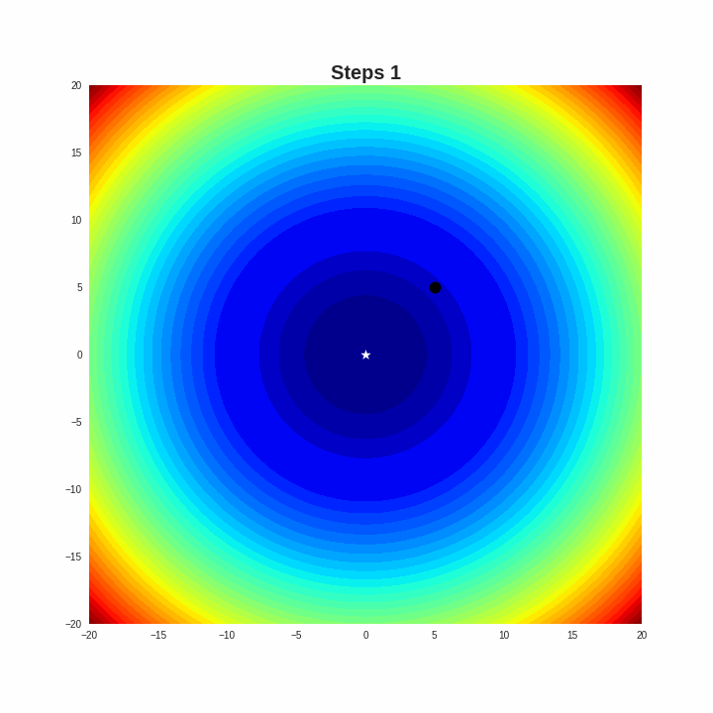

Slide 28
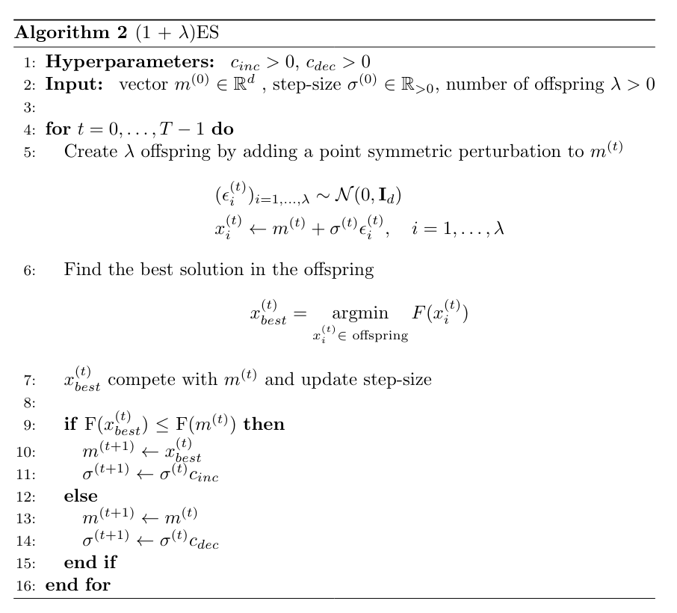
(1 + lambda) ES

Slide 29

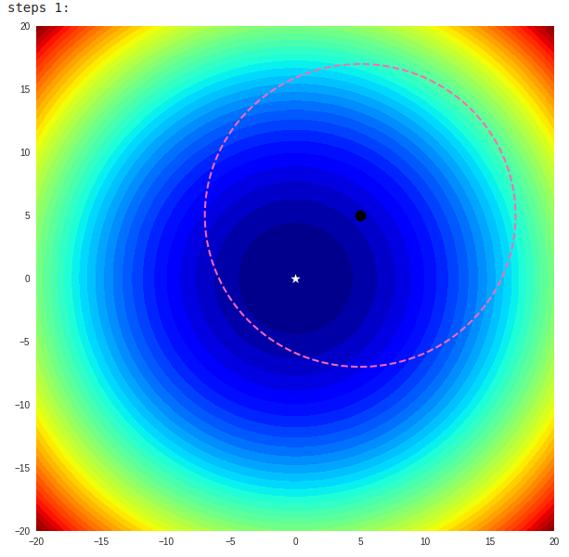

Slide 30
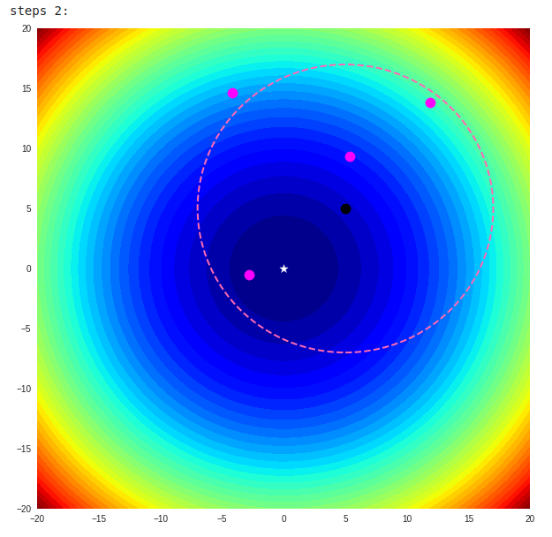
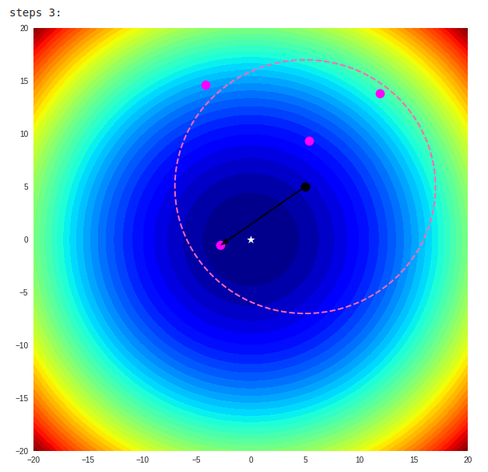

Slide 31

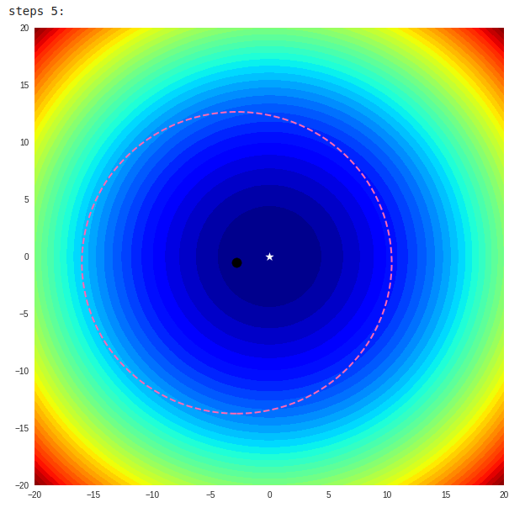

Slide 32
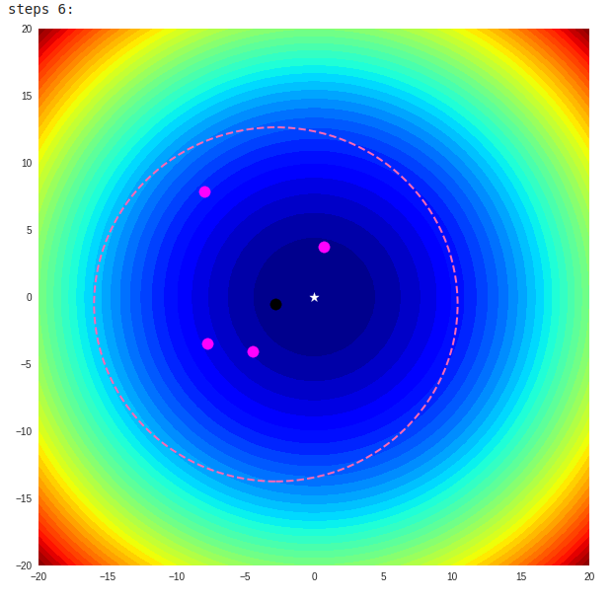
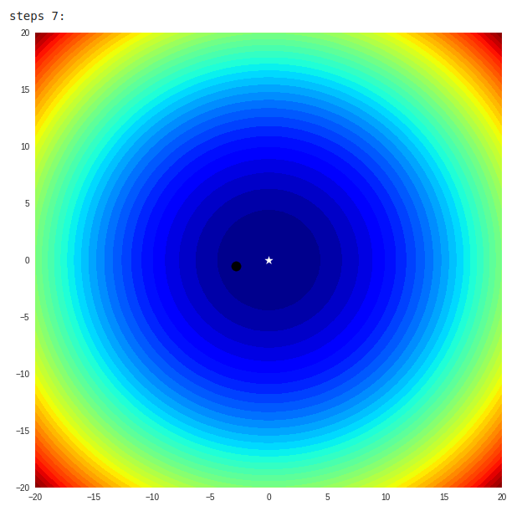

Slide 34
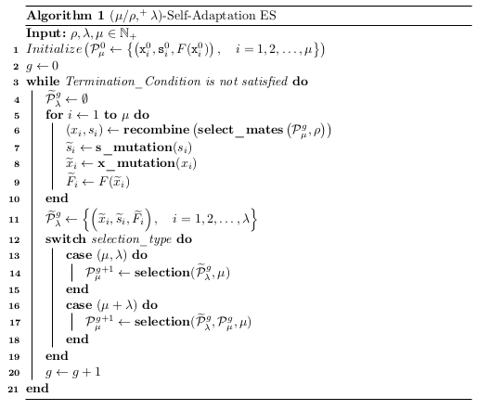
ES Algorithm

Slide 35
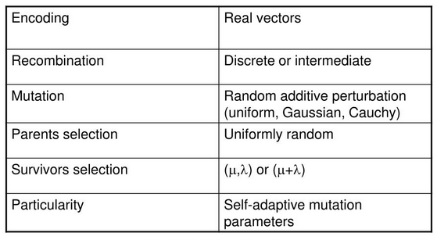
Summary

Slide 36
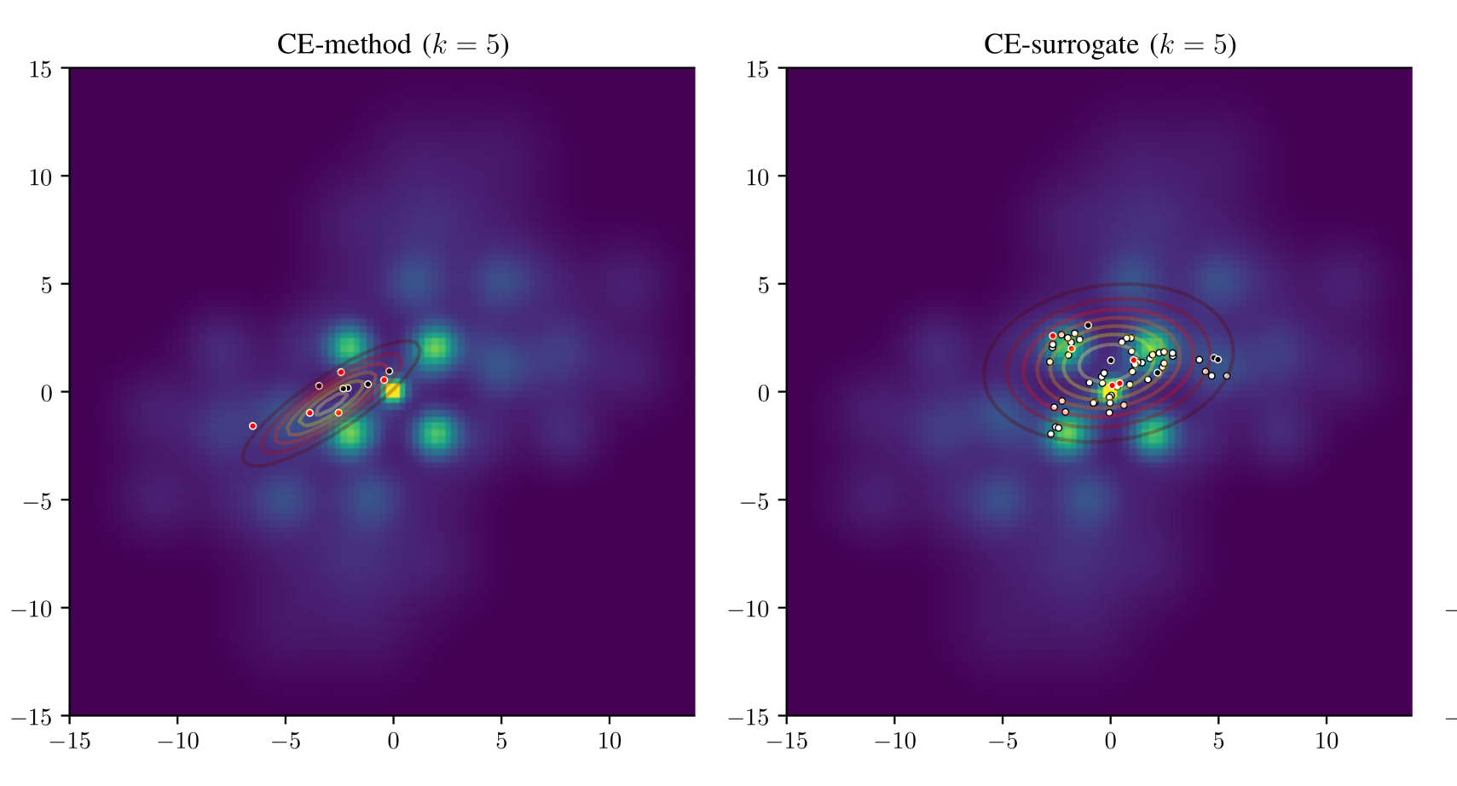
III. CEM
Fig:

Slide 37
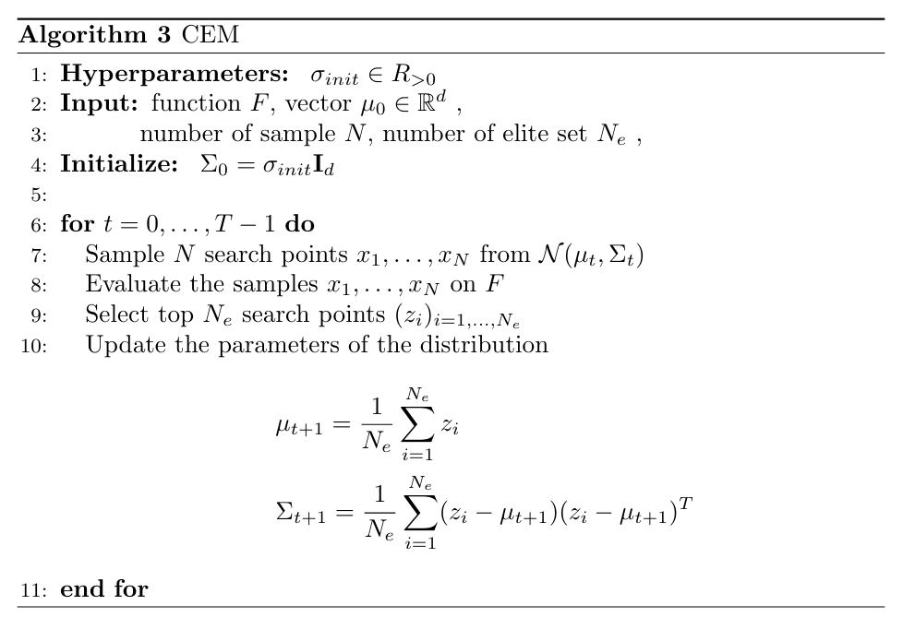

Slide 38
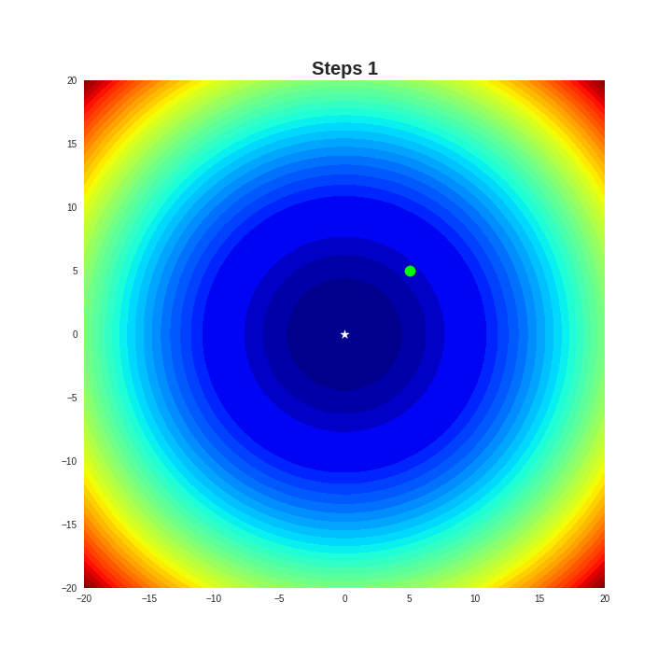

Slide 39
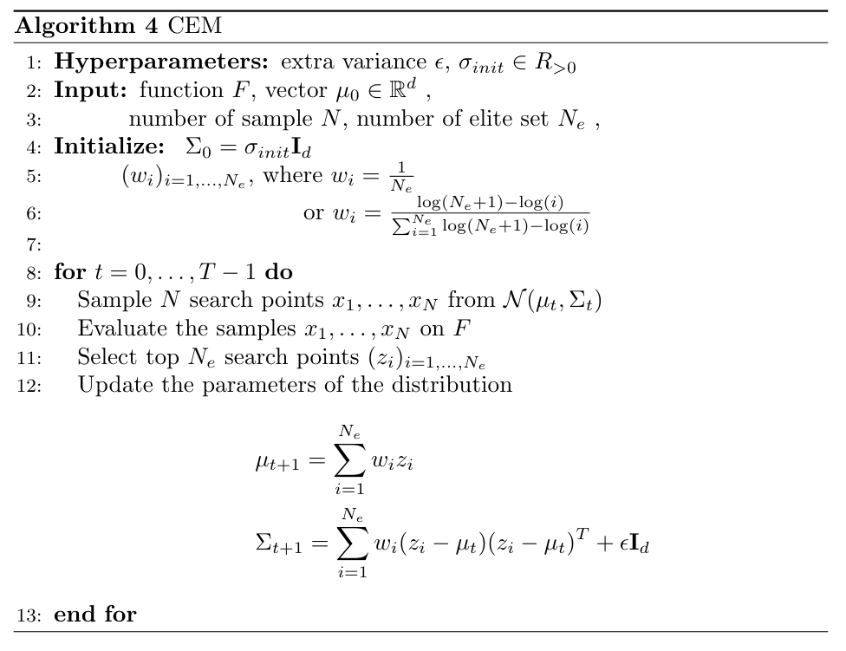

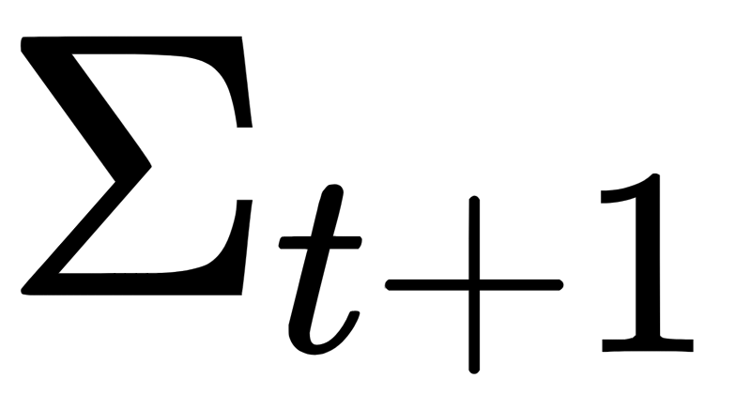
Some modify to prevent premature convergence
add to some noise
and use for updating

Slide 41
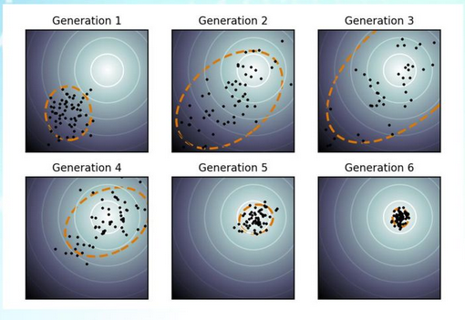
IV. CMA-ES

Slide 42
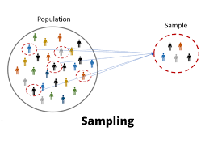
Sampling

Slide 43
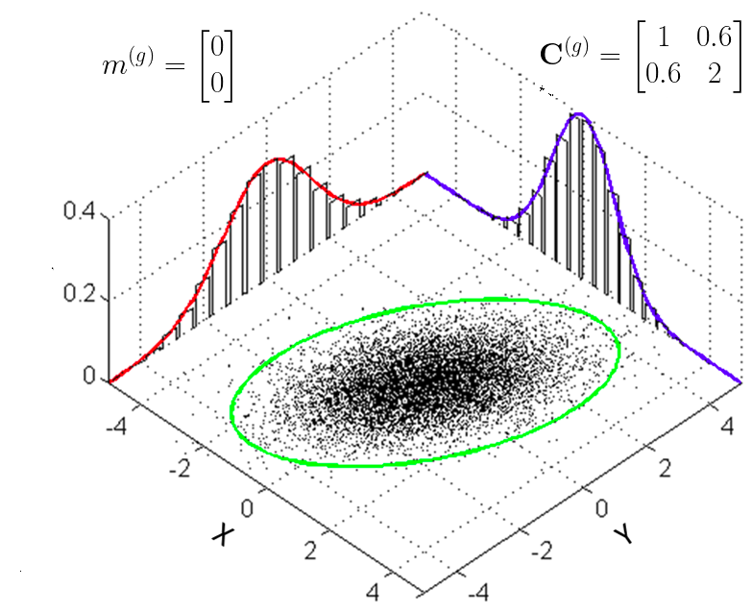



Sampling
New search points is generated by sampling a multivariate normal distribution:
Where,
Step size control the step length
The covariance matrix determines the shape of the distribution ellipsoid

Slide 44

Why Normal Distribution ?
Approximates many natural phenomena so well
Only stable distribution with finite variance
Most convenient way to generate isotropic search points
Maximum entropy distribution with finite variance

Slide 45

B. Selection and Recombination

Slide 46

Selection and Recombination
New mean value is computed as
Where,

Slide 47



Selection and Recombination
Intermediate recombination:
Weighted recombination:

Slide 48





Slide 49


Slide 50
C. Adapting the Covariance Matrix

Slide 51
Similar to the approximation of the inverse Hessian matrix
Adaptation of the covariance matrix amounts to learning a second order model of the underlying objective function similar to the approximation of the inverse Hessian matrix in the quasi-Newton method in classical optimization.

Slide 52


Similar to the approximation of the inverse Hessian matrix

Slide 53

Similar to the approximation of the inverse Hessian matrix

Slide 54


Similar to the approximation of the inverse Hessian matrix

Slide 55


Estimating the Covariance Matrix From Scratch
Estimate the distribution variance within the sampled points
Estimate variances of sampled steps

Slide 56

Estimating the Covariance Matrix From Scratch

Slide 57


Rank-μ-Update
To achieve fast search, the population size must be small
It is not impossible to get a reliable estimator for good covariance matrix
Information from previous generations is used additionally.
Where,

Slide 58

Cumulation The Evolution Path
Evolution Path: Conceptually, the evolution path is the search path the strategy takes over a number of generation steps. It can be expressed as a sum of consecutive steps of the mean m.
History information is accumulated in the evolution path

Slide 59

Cumulation The Evolution Path
Cumulation is a widely used technique and also know as
Exponential smoothing in time series, forecasting
Exponentially weighted moving average
Iterate averaging in stochastic approximation
Momentum in the back-propagation algorithm for ANNs
. . .
The simplest form of exponential smoothing is given by the formulas:

Slide 60

Rank-One-Update

Slide 61

Rank-One-Update
The adaptation increases the likelihood of successful steps

Slide 62




Rank-One-Update
Because the sign information is lost.

Slide 63

Combining Rank-μ-Update and Cumulation
CMA update of the covariance matrix combines Rank-μ-Update and Rank-One-Update

Slide 64
D. Step-Size Control

Slide 65

Step-Size Control
A larger step size leads to faster parameter update
Utilize an evolution path

Slide 66



Step-Size Control
Constructs an conjugate evolution path by summing up a consecutive sequence of moving steps

Slide 67

Algorithm

Slide 68


Link blog: A Visual Guide to Evolution Strategies

Slide 69
Advantage of CMA-ES
Non-separable problem
The derivative of objective function is not available
High dimension problems (n large)
Very large search space

Slide 70
CMA-ES Limitations
Partly separable problem
The derivative of objective function is easily available
Small dimension (n << 10)
Small running times (number off-evaluations < 100n)

Slide 71

Hans-Georg Beyer
A research professor at the Research Center Business Informatics
Simplify Your Covariance Matrix Adaptation Evolution Strategy (2017)
https://homepages.fhv.at/hgb/

Slide 72

MA-ES

Slide 73

MA-ES

Slide 74


Removing the p and the C in CMA-ES
Provided that
Provided that asymptotically holds for , p can be drop

Slide 75


Removing the p and the C in CMA-ES
The ratio is only a slightly decreasing function of N that does not deviate too much from 1. Therefore, one would not expect a much pronounced influence on the performance of the CMA-ES.

Slide 76



Removing the p and the C in CMA-ES

Slide 77

CMA-ES vs MA-ES

Slide 78

CMA-ES vs MA-ES

Slide 79



Fast MA-ES (matrix x vector)

Slide 80

LM MA ES
By omitting the rank-μ update for the sake of simplicity (i.e., by setting cμ = 0), we obtain:

Slide 81




LM MA ES
Tran is a scalar does not require to be stored in memory.
Using the last m vector (direction vectors) to update matrix M

Slide 82

LM MA ES

Slide 83

LM MA ES

Slide 84

LM MA ES

Slide 85



